Slide 1
Milestone 2: Invoice & Receipt Digitization System
Field Extraction, Validation & Database Storage Using OCR, Regex and NLP

Slide 2
The Challenge: Manual Invoice Processing
1
2
3
Time-Consuming
Error-Prone
Inefficient Workflows
Manual entry of invoice data is a significant drain on valuable resources, slowing down critical financial operations and diverting personnel from higher-value tasks.
Human error in data transcription leads to inaccuracies, potential financial discrepancies, and increased audit risks, impacting overall data integrity and reliability.
The lack of automation creates bottlenecks in the accounts payable process, delaying payments, hindering vendor relationships, and reducing operational efficiency.
Our solution addresses the critical need for an automated system to accurately extract, validate, and store invoice data digitally.

Slide 3

MILESTONE 2
Key Objectives Achieved
01
Field Parsing & Extraction
Applied Regex and NLP techniques to precisely parse and extract key invoice fields, ensuring high accuracy.
02
Financial Validation
Implemented logic to validate subtotal, tax, and total amounts, cross-referencing figures for consistency.
03
Duplicate Detection
Developed mechanisms to detect and prevent duplicate invoice entries, maintaining data integrity.
04
Database Storage
Successfully integrated the system to store structured invoice data into a robust database for easy retrieval and analysis.

Slide 4
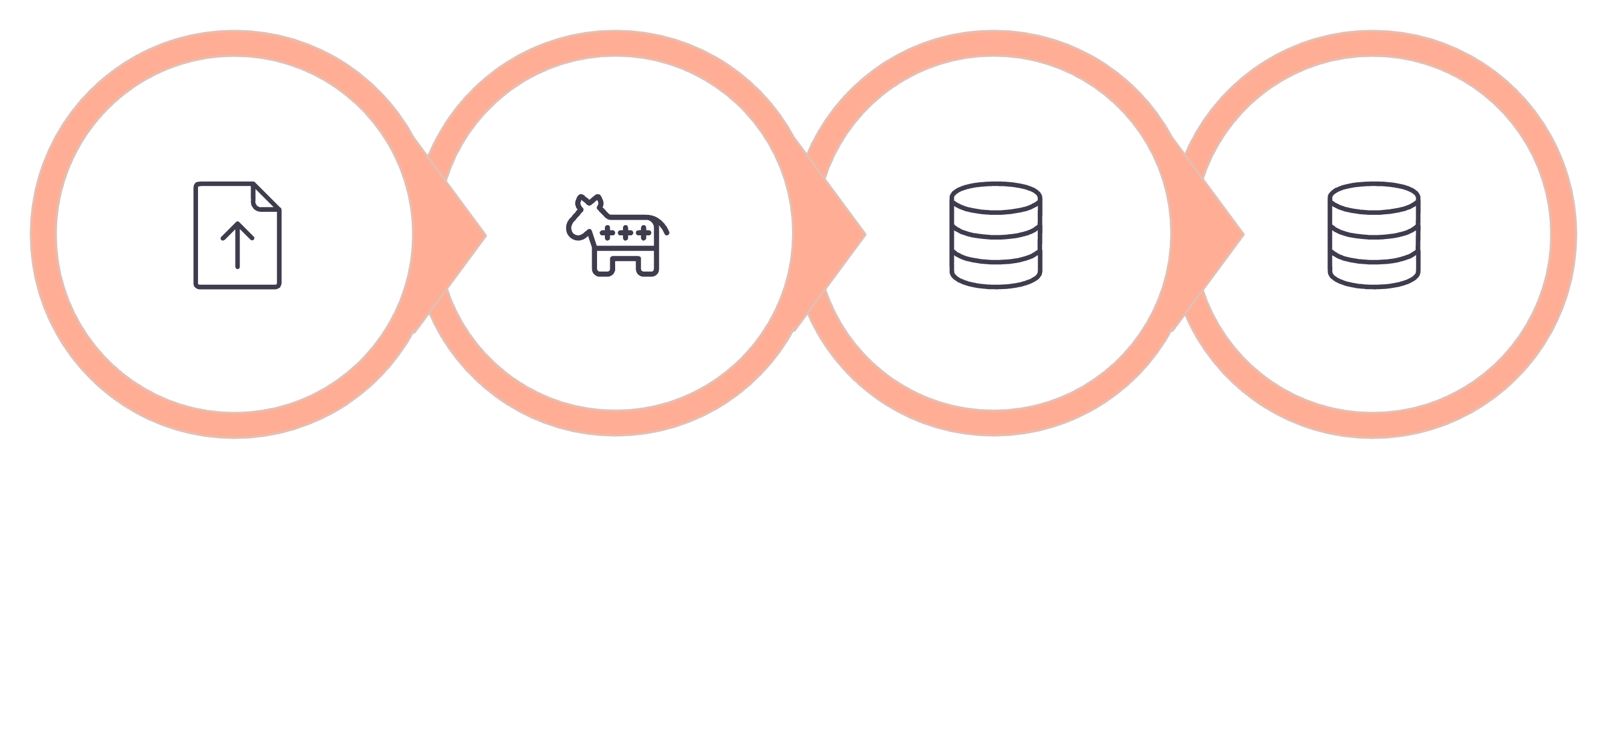



End-to-End System Overview
Invoice Input
OCR Processing
Data Extraction
Database Storage
Our system streamlines the entire invoice lifecycle, transforming raw documents into actionable, structured data.

Slide 5
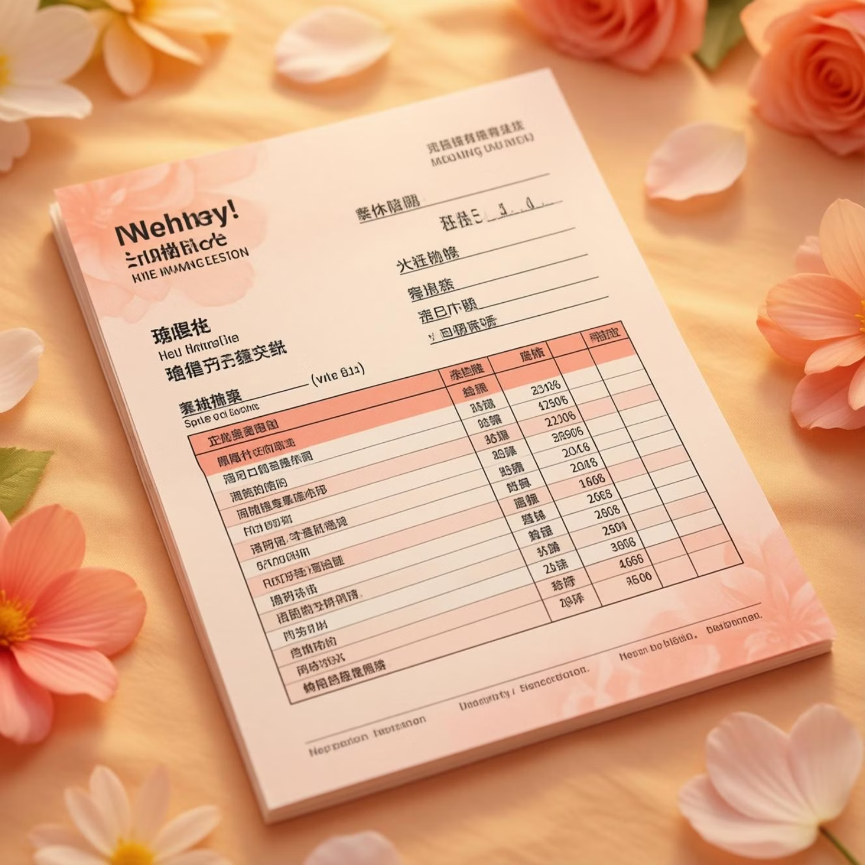
OCR & Image Preprocessing
Optimized Clarity
Leveraging OpenCV for advanced image preprocessing, including noise removal and thresholding, ensures optimal clarity for text recognition.
Robust Text Extraction
Tesseract OCR engine is integrated for powerful and accurate text extraction, converting visual data into machine-readable format.
Versatile Input
The system is designed to seamlessly process both image files (JPG, PNG) and PDF invoices, offering flexibility for various document types.

Slide 6
Intelligent Field Extraction
Core Invoice Details
Extracts essential information like store name, unique invoice numbers, and transaction dates with high precision using advanced Regex patterns.
Financial Summation
Accurately identifies subtotal, tax amounts, and the grand total on invoices, enabling automated financial reconciliation.
Detailed Line Item Parsing
Utilizes Natural Language Processing (NLP) to parse individual line items, extracting description, quantity, unit price, and total amount for each entry.

Slide 7



Rigorous Validation Logic
Subtotal + Tax = Total
Tolerance Checks
Error Flagging
Automated calculation to verify that the sum of subtotal and tax precisely matches the invoice's total amount, ensuring arithmetic correctness.
Incorporates tolerance checks to account for minor discrepancies due to rounding or OCR anomalies, minimizing false positives.
Automatically highlights and flags validation errors, enabling users to quickly identify and address mismatches, maintaining data quality.

Slide 8

Ensuring Data Consistency
1
Invoice Number-Based Detection
Our system employs sophisticated algorithms to identify duplicate invoices based on unique invoice numbers, preventing redundant entries.
2
Preventing Redundancy
This critical feature ensures that the same invoice is not stored multiple times, streamlining data management and reducing clutter.
3
Maintaining Data Integrity
By eliminating duplicates, we enhance the overall consistency and reliability of the database, providing a clean and accurate record for financial operations.

Slide 9




Secure Database Storage
Structured Data
All extracted invoice data is meticulously structured and stored in a robust database, optimized for efficient query and retrieval.
Comprehensive Records
Beyond core fields, the system stores rich invoice metadata, original extracted text, and detailed line items for complete record-keeping.
Future-Proof Analytics
The organized data foundation enables powerful future analytics, business intelligence reporting, and compliance auditing capabilities.

Slide 10
CONCLUSION
Milestone 2: A Leap Forward in Automation
Enhanced Accuracy
Boosted Efficiency
Increased Reliability
Automated extraction and validation significantly reduce human error, leading to more precise financial data.
Elimination of manual processes accelerates invoice handling, freeing up resources and improving operational throughput.
Consistent data storage and duplicate detection ensure a dependable and trustworthy source of truth for all invoice-related operations.
This milestone marks a significant step towards a fully automated, intelligent invoice processing system, driving greater business value.

